Slide 1

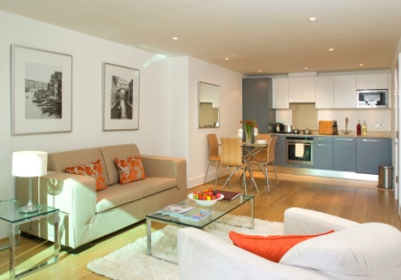
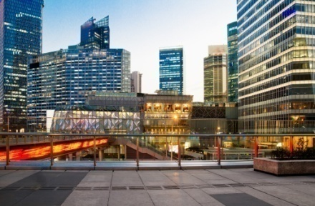

Strengthen Global Empower Local Oakwood Worldwide Global Overview CHPA, New Orleans Richard Whittaker Director, Supplier Management - Europe, Middle East & Africa (EMEA)
24 February 2014

Slide 2
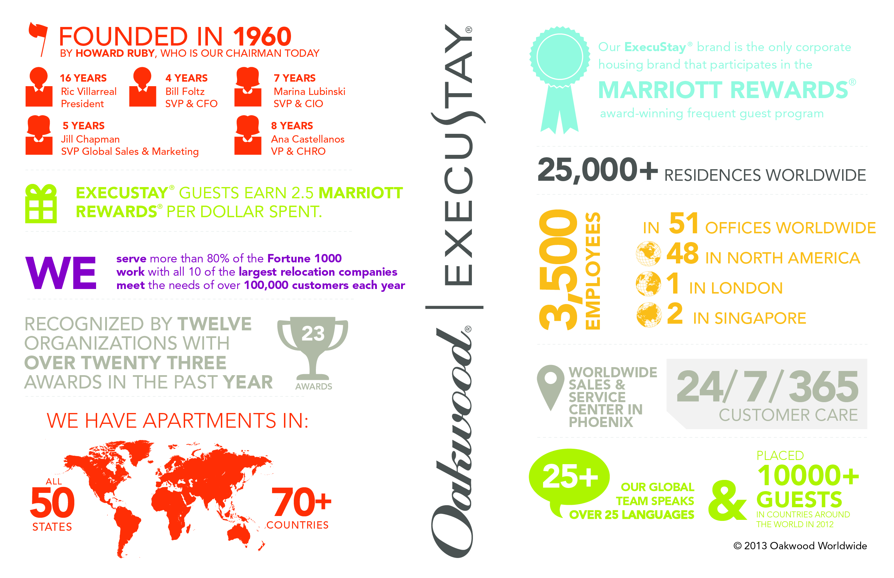
Oakwood Worldwide® at a Glance

Slide 3
Global Housing Solutions
70,000 bookings worldwide in more than 75 countries in 2013
More than 50,000
More than 1,000
250 to 999
100 to 249
50 to 99
1 to 49
Notes:
David Holt
Q: Where does the Supplier have their own apartment buildings (specific states, countries) vs. where does it utilize third-party providers (specific locations) in relation to Sapients global needs.
Sapient Global Locations
Oakwood Worldwide-Owned Apartments/Supplier-Owned Apartments
Bangalore 139 1,200
Brisbane N/A 1,700
Calgary N/A 2,800
Cologne N/A N/A
Dusseldorf N/A 200
Gurgaon N/A 500
London 400 11,000
Melbourne N/A 300
Moscow N/A 1,600
Munich N/A 2,800
Noida N/A 500
Sao Paulo N/A 4600
Schaffhausen N/A 600
Shanghai 112 1,100
Singapore N/A 6,000
Stockholm N/A 1,200
Sydney N/A 2,300
Toronto N/A 2,800
Zurich N/A 1,250

Slide 4
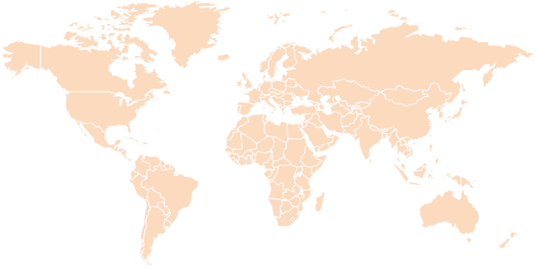
Global Footprint
Regional HQ –
Toronto
Regional HQ –
London
Global HQ –
Los Angeles
WSSC & Regional HQ
Phoenix
Regional HQ –
Singapore
Able to work in Local Time Zones
Local Expertise
Understand local business cultures

Slide 5
United States
Presence
Global Headquarters in Los Angeles
Worldwide Sales and Service Centre in Phoenix
Supply Chain Resource in Phoenix
47 US District Offices including
2013: Accommodated over 50,000 guests; 3 million Room Nights
Highlights
Fulfilled needs in over 2,000 locations
Pioneered the Serviced Apartment concept
Multi-brand offering, Oakwood and ExecuStay
Partnership with Marriott International

Slide 6
Canada & Latin America
Presence
Satellite Office – Toronto, Canada
Canada – 220 Network Partners
Latin America – 157 Network Partners
16 associates dedicated to delivery of Global Client Services
2013: Accommodated over 1,800 guests; 132,000 Room Nights in 140 cities and 12 countries
Highlights
Strategic Partnerships to meet demand in key markets
Supply chain manager located in Canada
Supply chain manager dedicated to Latin America
Americas Global Service Centre – Phoenix

Slide 7
Asia Pacific
Presence
Regional HQ Singapore
27 Oakwood Branded Properties totaling 3,800 apartments
One of the BIG 3 Operators in Asia Pacific
400+ Network Partners, servicing 1st, 2nd & 3rd tier cities
2013: Accommodated over 2,850 guests; 160,000 Room Nights in 104 cities and 20 countries
Highlights
E-Procurement via Lanyon – 300 serviced apartment properties
TIDS (Travel Industry Designator Service) Certification
GDS Booking Capabilities
Abacus Hotel & Abacus Room Deal
Accommodation Solutions – transient through extended stay
Branded property development pipeline

Slide 8
Europe, Middle East & Africa
Presence
Regional HQ London
Supply Chain Resource, London
510 managed apartments within central London
360 network partners covering the EMEA region
75 Associates
2013: Accommodated over 5,800 guests; 287,000 Room Nights in 409 cities and 45 countries
Highlights
Global Housing Program, regionally managed
Regional operations center
Accommodation Solutions – transient through extended stay
12 languages spoken in the reservations team to service clients, guests, and suppliers

Slide 9
Regional Revenue Share
Region | % of 2013 Revenue | Global Inventory
USA | 67% | Leased Inventory Supply Chain Branded Buildings
APAC | 22% | Supply Chain Branded Buildings
EMEA | 7% | Leased Inventory Supply Chain Branded Buildings
Canada | 3% | Supply Chain
Latin America | 1% | Supply Chain

Slide 10
What are Oakwood’s clients looking for

Slide 11
Technology and Data Protection
Electronic signature and enterprise content management system
CRM tool
Siebel
EchoSign
Automated emergency notification system
Mobile resource management tool
Everbridge
Xora
CLIENT
OSCAR
EPICSM
Property management and accounting software solution
e-procurement sourcing technology platform
ServiceTrackSM
Comprehensive, closed-loop issue-tracking system

Slide 12
Market Intelligence – Supply Chain
Sourcing
Identifying priority markets
Client driven
Supplier performance
Vetting
Objective scoring methodology
Compliance OFAC, FCPA, EU Safe Harbor)
Standard Service Level Agreements
Managing
Client specific terms of business & RFP in key markets
Quarterly reviews and market visits
Continue to drive value proposition for network partners
On-Boarding
Training on Oakwood Worldwide/Client specific standards and expectations
Standard Operating Procedures

Slide 13
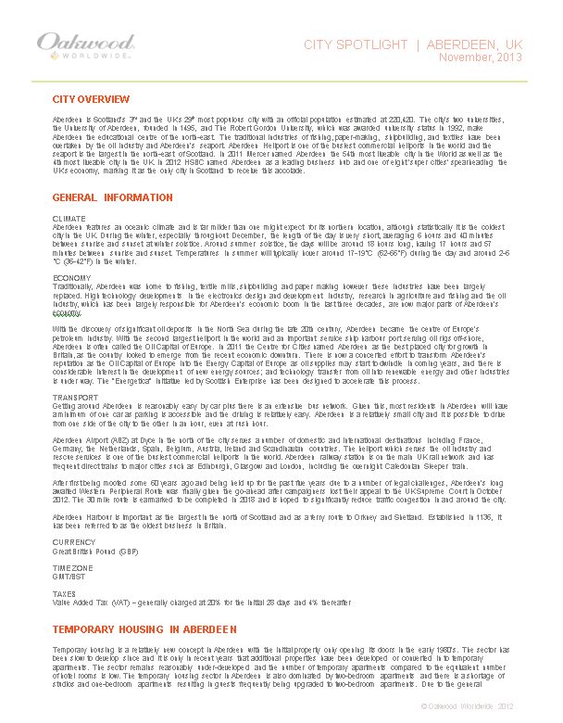
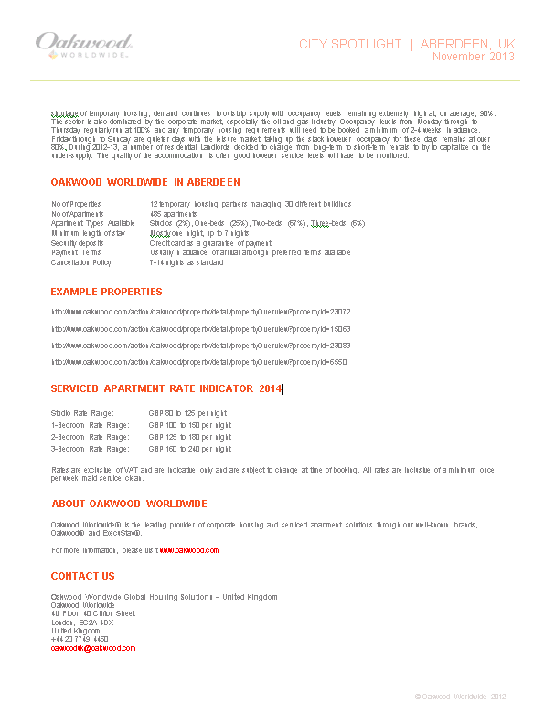
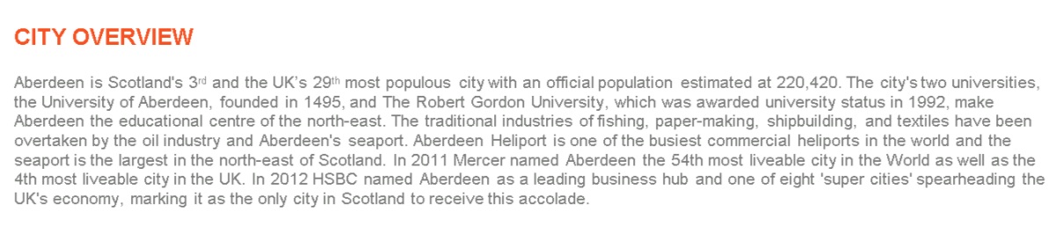
City Spotlight Summary

Slide 14
Components of Duty of Care
Physical Safety & Security
Property standards
Gap analysis and remediation
Best practices shared globally
Business Continuity Planning
Off-site data storage
and information
retrieval
Ability to run day-to-
day matters remotely
in all locations
Disaster Preparedness
Standardised regional preparation documentation
Regular periodic disaster drills
Leverage historical event best practices
Information Safety & Security
EchoSign for PCI and electronic documents
EU Safe Harbor certification
Non-corrupt practices compliance with all business partners
Mass Notification & Communication
Everbridge notification system
Tracking of guests’ location, well-being and crisis situation awareness
Education & Training
Enterprise-wide focus on
Duty of Care
Annual review / updating of all documentation
Crisis simulation drills
Included in OWW
Associate on-boarding

Slide 15
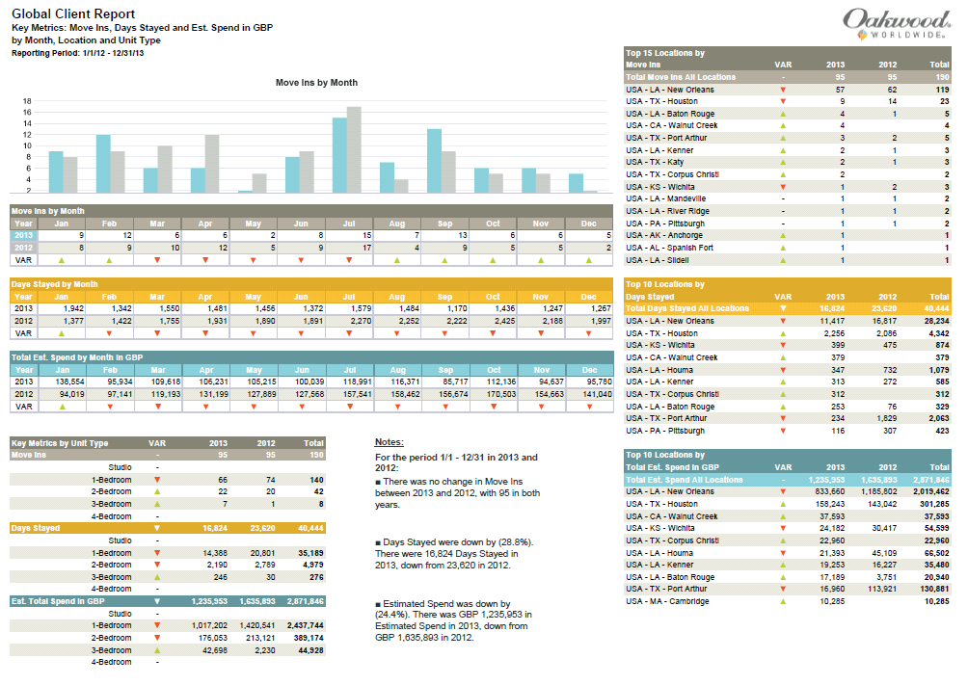
Reports

Slide 16
Global Franchise Opportunities
EMEA LATIN AMERICA
Germany Mexico
The Netherlands Brazil
N. Switzerland Dominican Republic
S. Switzerland
Nigeria
Russia
Key Benefits:
Access to/ownership of OW’s pipeline of business in the markets in which they operate
Access to OW’s IT software and Global Sales & Marketing
Stronger and more powerful as OW, aligned with a globally recognized
brand with a massive US & APAC footprint
Easier access, and greater referral opportunities, in to OW’s global
inventory/supply chain, specifically in to the US

Slide 17

Thank You

Slide 19



Ability to Provide Housing Where Needed
Supply Chain
Leased Inventory
Branded Buildings
Source accommodations from global housing network partners
Refer clients directly or place as our guest
Billing through Oakwood Worldwide available
Lease a subset of units within third-party-owned apartment buildings
Fully furnished units and lease to clients
Inventory flexes to match demand in any given market
Master lease entire building in key markets
Furnish anywhere from 30% to 100% of the units for corporate use
Lease the balance of the units as conventional rental units

Slide 20
Our Commitment to Duty of Care
Oakwood Worldwide defines “duty of care” as the business and ethical obligation to provide a standard of reasonable care that seeks to mitigate potential risks and minimise the impact of unanticipated events that may occur while providing products and services to clients, guests, associates, stakeholders and business partners.
We do this by:
Evaluating and communicating risks to clients in order to set realistic expectations during their stay
Demonstrating both proactive and reactive measures to unanticipated events through predefined activities and timely and accurate communications
Standardising the property security environment and stay experience by fully leveraging our span of control over both managed and business affiliate property vetting and inspection.

Slide 21
Top 10 EMEA Locations Booked 2013
Location | Move-Ins | Room Nights
London | 3,330 | 126,010
Dublin | 207 | 12,332
Dubai | 138 | 7,208
Aberdeen | 89 | 6,426
Frankfurt | 131 | 6,223
Amsterdam | 106 | 5,962
Paris | 112 | 5,179
Luxembourg | 83 | 4,918
Geneva | 70 | 4,610
Brussels | 55 | 4,056

Slide 22


Service Excellence
In-region Specialists
Tri-regional Centers of Excellence
Supply Chain Partner Management
Call Center: 24/7/365
Operations Teams
Dedicated Global Account Support Team
Fulfilment Teams
Phoenix
(U.S., Canada, Latin America)
Account Management
Finance Teams
London
(EMEA)
Singapore
(APAC)
Notes:
Craig Ryan
Q-Please explain to us your best in class practices and innovations that you would bring to our program if selected?
Q- Please take a few moments to tell us what differentiates you from your competitors.
26 languages
Financial transactions in 70 countries

Slide 23
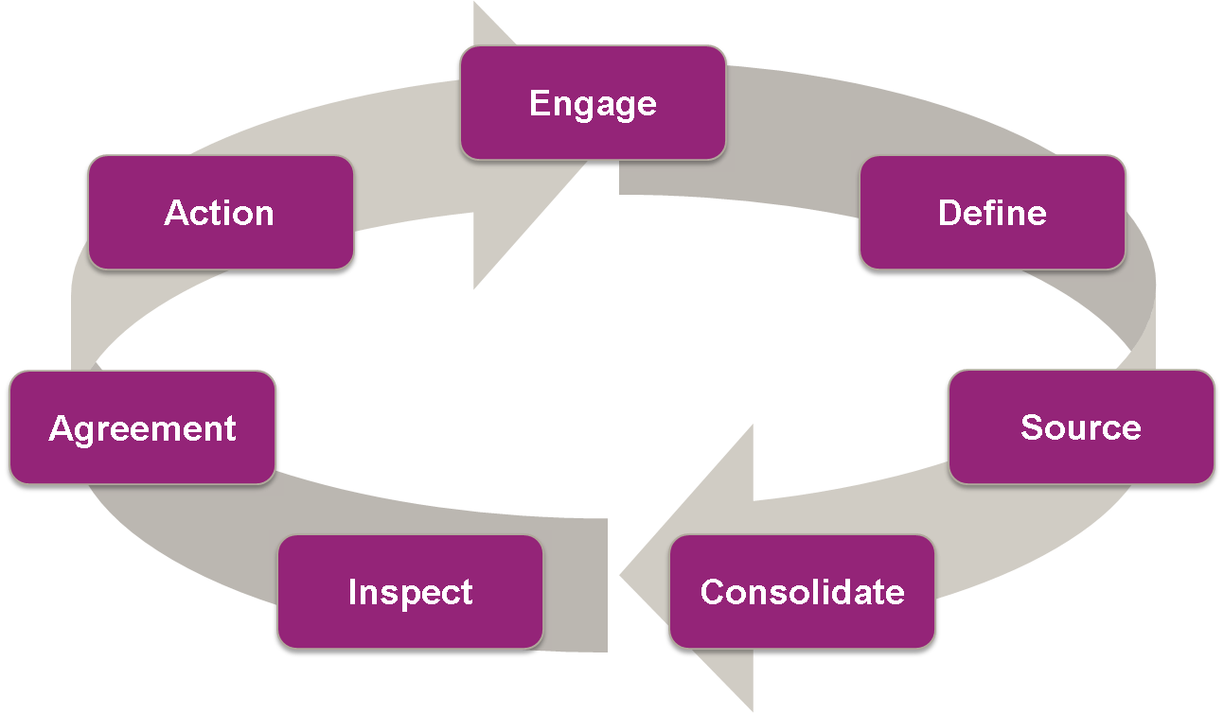
Oakwood Worldwide’s Global Capability
Example 1: Calgary, Canada
Example 2: Appalachia, Pennsylvania
Implement

Slide 24
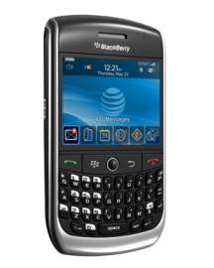



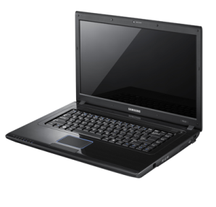
Service Excellence
Comprehensive, closed-loop issue-tracking system used to document and proactively address guest requests
RESOLVED
Guest reports service request via phone or email
Request entered into ServiceTrackSM, time- and date-stamped
Request assigned to a dedicated Customer Service Representative
Representative confirms guest’s service request has been resolved to satisfaction

Slide 25
Globale sales strategy
How many sales folks arund te world
Selling locally but also globally
10 SCManagers around the world selling outboun solutions to their locak clients
Due diligence / duty of care / crisis management
Sourcing solutions & contacts around the world
SCM giving leads o sales & sales giving leads to SCM
On the road / making connections
Finding solutions
Epic training
Selling Oakwood globally
Benefits of being an Oakwood franchise:
Global name, brand & reputation
Easier selling as OW than a local name
Outbound sales & revenue opportunities
Access to OW’s property inventory, especially in the US – known globally as the market leader
IT infrastructure to make it easier for lead flow both inbound & outbound
Franchise Agreements close to closure:
Germany
The Netherlands
Nigeria
Moscow
S. Switzerland
N. Switzerland

